Slide 1
CHGM-141
General and Analytical Chemistry I
Lecture 24
(Ch.9) with Dr. Bailey
Gases and Their Properties
States of Matter and Their Changes
The Properties of Gases
The Kinetic-Molecular Theory of Gases
Pressure

Slide 2
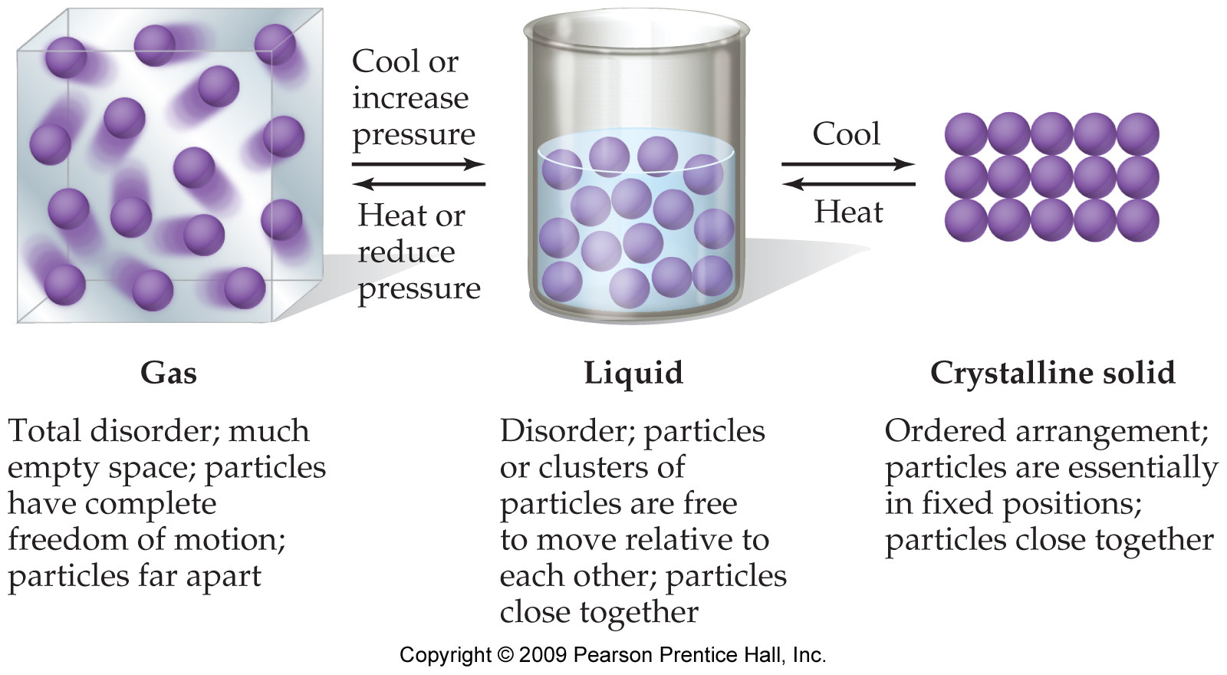
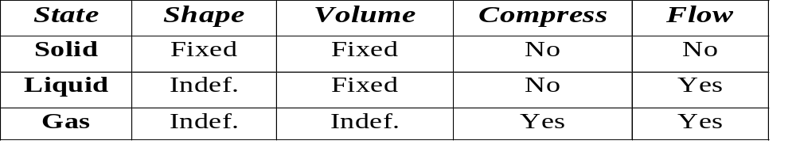
States of Matter
Matter can exist in any of three phases, or states- solid, liquid, and gas depending on the strength of the attractive forces among the particles in the substance.
The gas
molecules have
enough kinetic
energy to overcome
attractions
Fixed = keeps shape when placed in a container
Indefinite = takes the shape of the container
Importance of Gases…

Slide 3
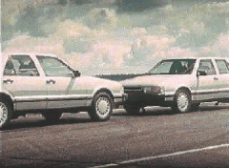
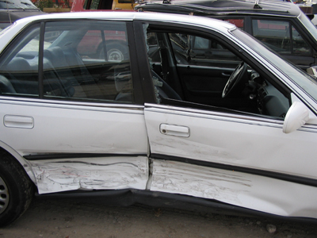

Importance of Gases
Airbags fill with N₂ gas in an accident.
Gas is generated by the decomposition of sodium azide, NaN₃.
2 NaN₃ (s) ---> 2 Na(s) + 3 N₂ (g)
Another example…

Slide 4


Hot Air Balloons —
How Do They Work?
Composition of dry air…

Slide 5
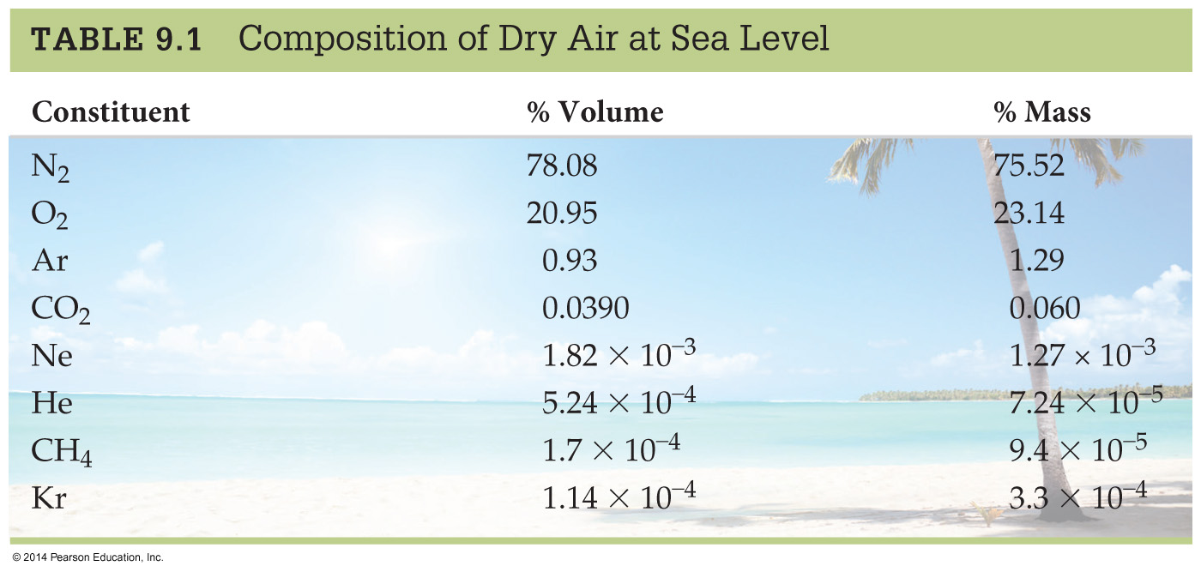
Behavior of gases…
Notes:
Chapter 9: Gases: Their Properties and Behavior
Copyright © 2010 Pearson Prentice Hall, Inc.

Slide 6

KINETIC MOLECULAR THEORY of Gases
(KMT)
Theory used to explain gas laws.
KMT assumptions are:
Gases consist of molecules or atoms in constant, random motion flying around very fast in their container(s).
No attractive or repulsive forces between molecules. Collisions elastic.
When the moving particles hit another particle or the container, they do not stick, but they bounce off and continue moving in another direction.
  Like billiard balls.
P arises from collisions with container walls.
Volume of molecules is negligible.

Slide 7

KINETIC MOLECULAR THEORY Gas Properties Explained
There is a lot of empty space between the particles in a gas.
  Compared to the size of the particles.
The average kinetic energy of the particles is directly proportional to the Kelvin temperature.
  As you raise the temperature of the gas, the average speed of the particles increases.
    But don’t be fooled into thinking all the particles are moving at the same speed!!

Slide 8
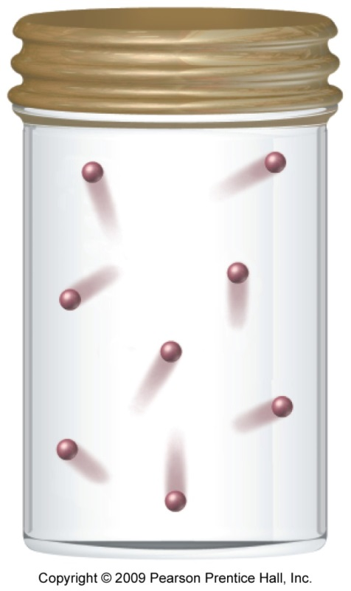
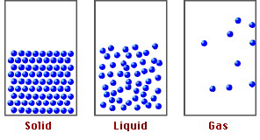
Properties—Indefinite Shape and Indefinite Volume
Gases have taken the shape and volume of their container(s) because the particles don’t stick together, allowing them to move and fill the container(s) they’re in.
  In solids and liquids, the particles are attracted to each other strongly enough so they stick together.

Slide 9
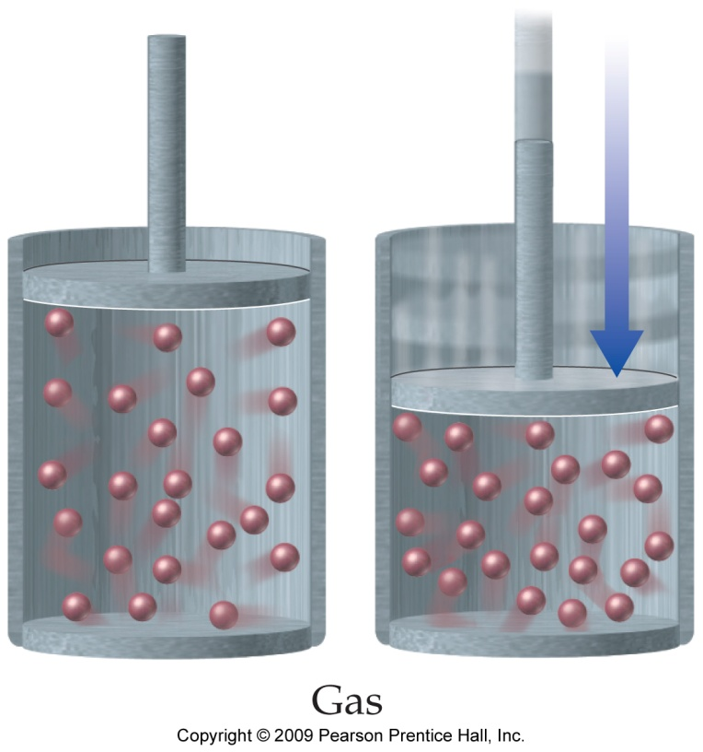
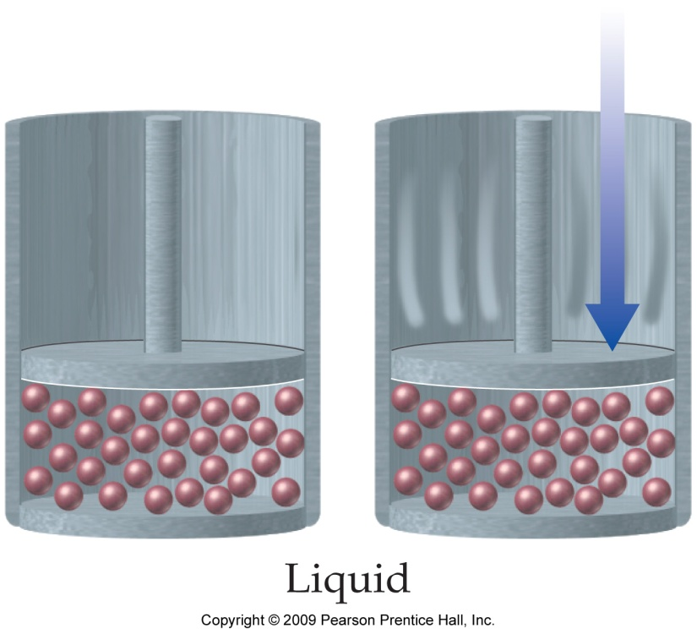
Properties — Compressibility
Gases are compressible because of the large amount of unoccupied space between the particles.
Because there is a lot of unoccupied space in the structure of a gas, the gas molecules can be squeezed closer together.

Slide 10

Gas Properties —
Low Density
Because there is a lot of unoccupied space in the structure of a gas, gases do not have a lot of mass in a given volume, the result is that they have low density.
Mixtures of gases are always homogeneous.

Slide 11
THE PRESSURE OF A GAS

Slide 12
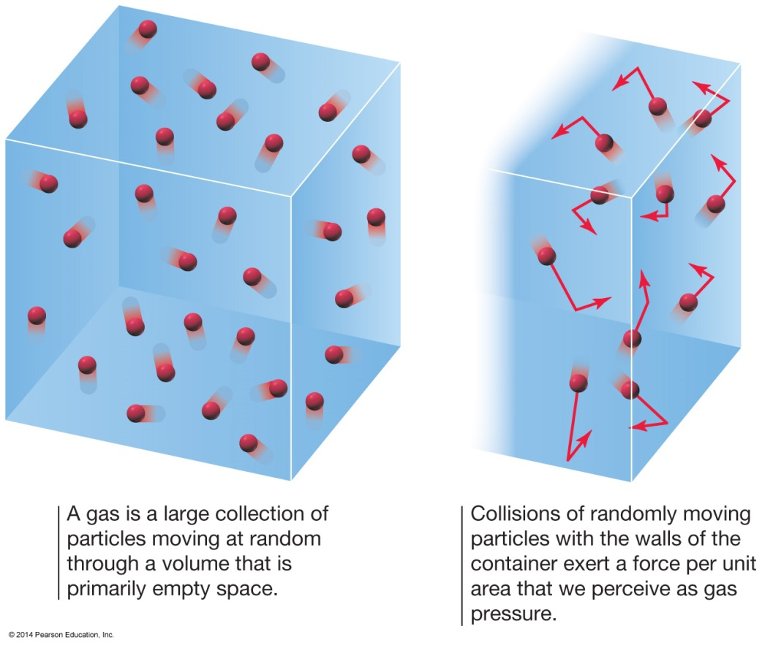
Gas Particles Pushing
The Pressure of a Gas
Gas molecules are constantly in motion.
As they move and strike a surface, they push on that surface.
  Push = force.
  Pressure = force per unit area.

Slide 13
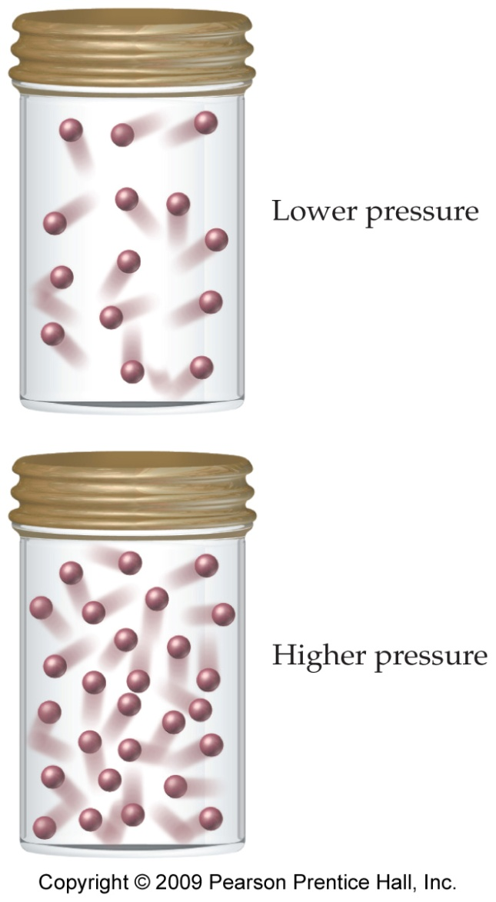
The Pressure of a Gas
Again..
Pressure is the result of the constant movement of the gas molecules and their collisions with the surfaces around them.
The pressure of a gas depends on several factors:
  Number of gas particles in a given volume.
  Volume of the container.
  Average speed of the gas particles.

Slide 14
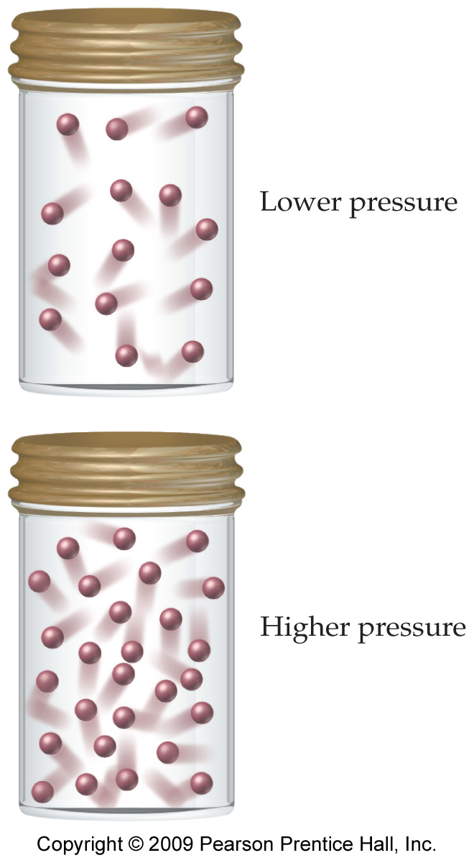
Density and Pressure
When more molecules are added, more molecules hit the container at any one instant, resulting in higher pressure.
  Also higher density

Slide 15
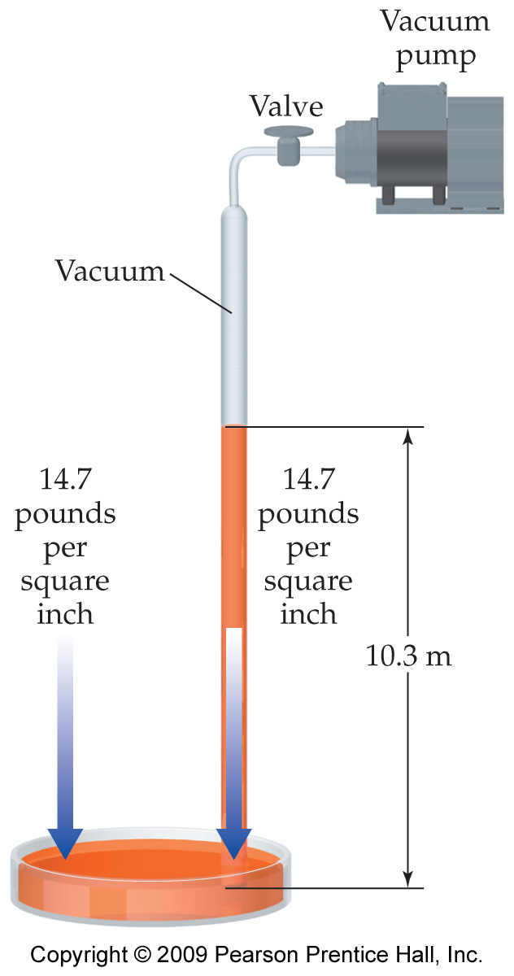
Air Pressure
We on earth are under pressure from the atmosphere, the blanket of air pressing down on us.
The atmosphere exerts a pressure on everything it contacts.
Pressure (p): Force (F) per unit area (A); that is, F/A .
  The atmosphere goes up about 370 miles, but 80% is in the first 10 miles from Earth’s surface.
  On average 14.7 psi.
This is the same pressure that a column of water would exert if it were about 10.3 m high.
Atmospheric pressure is not constant, it varies slightly from day to day depending on the weather and also varies with altitude.

Slide 16
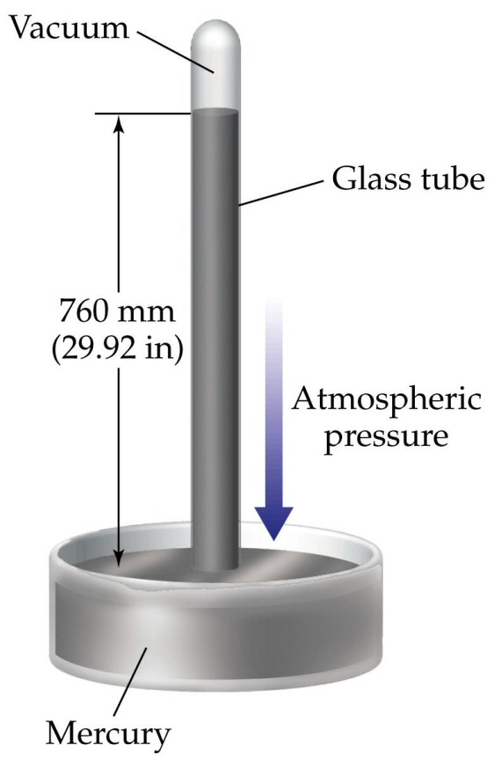
Measuring Air Pressure
Pressure of air is measured with a BAROMETER (developed by Torricelli in 1643)
Hg rises in tube until force of Hg (down) balances the force of atmosphere (pushing up).
Force of the air on the surface of the mercury balanced by the pull of gravity on the column of mercury.
Column height measures P of atmosphere
gravity

Slide 17
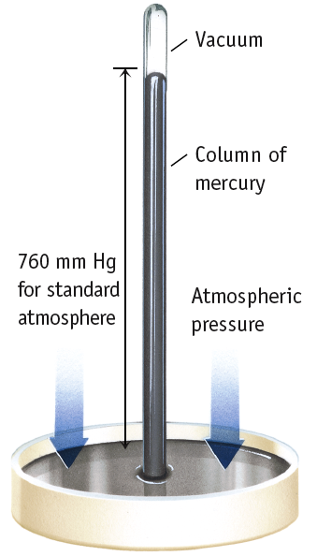
Measuring Pressure
Column height measures P of atmosphere
1 standard atm
= 760 mm Hg
= 29.9 inches Hg
SI unit is PASCAL, Pa, where
1 atm = 101.325 kPa

Slide 18
Common Units of Pressure
Unit | Average air pressure at sea level
Pascal (Pa) | 101,325
Kilopascal (kPa) | 101.325
Atmosphere (atm) | 1 (exactly)
Millimeters of mercury (mmHg) | 760 (exactly)
Inches of mercury (inHg) | 29.92
Torr (torr) | 760 (exactly)
Pounds per square inch (psi, lbs./in²) | 14.7

Slide 19
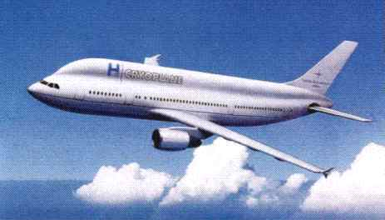
Atmospheric Pressure and Altitude
The higher up in the atmosphere you go, the lower the atmospheric pressure is around you.
  At the surface, the atmospheric pressure is 14.7 psi, but at 10,000 ft it is only 10.0 psi.
Rapid changes in atmospheric pressure may cause your ears to “pop” due to an imbalance in pressure on either side of your ear drum.

Slide 20
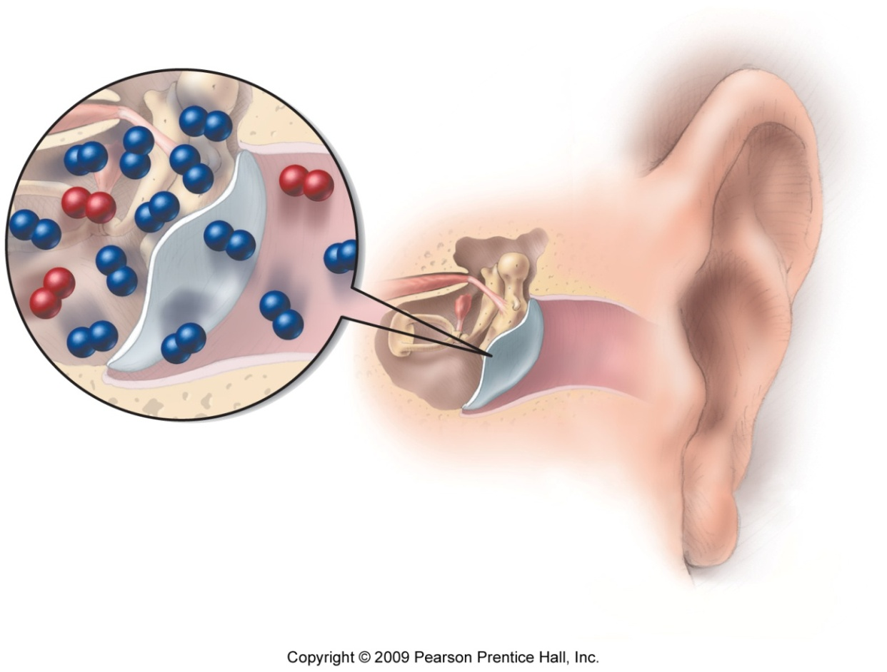
Pressure Imbalance in Ear
If there is a difference
in pressure across
the eardrum membrane,
the membrane will be
pushed out —what we
commonly call a
“popped eardrum.”

Slide 21
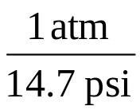
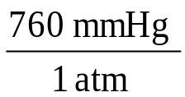
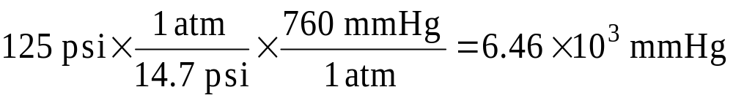
Example —A High-Performance Bicycle Tire Has a Pressure of 125 psi. What Is the Pressure in mmHg?
Given:
Find:
125 psi
mmHg
Solution Map:
Relationships:
1 atm = 14.7 psi, 1 atm = 760 mmHg
psi
atm
mmHg
Solution:
Check:
Since mmHg are smaller than psi, the answer makes sense.

Slide 22
Example :
A high-performance road bicycle is inflated to a total pressure of 125 psi. What is the pressure in millimeters of mercury?

Slide 23
Example:
A high-performance road bicycle is inflated to a total pressure of 125 psi. What is the pressure in millimeters of mercury?
Write down the given quantity and its units.
Given: 125 psi

Slide 24
Example:
A high-performance road bicycle is inflated to a total pressure of 125 psi. What is the pressure in millimeters of mercury?
Information:
Given: 125 psi
Write down the quantity to find and/or its units.
  Find: ? mmHg
Tro's Introductory Chemistry, Chapter 11

Slide 25
Example:
A high-performance road bicycle is inflated to a total pressure of 125 psi. What is the pressure in millimeters of mercury?
Information:
Given: 125 psi
Find: ? mmHg
Collect needed conversion factors:
  14.7 psi = 760 mmHg

Slide 26
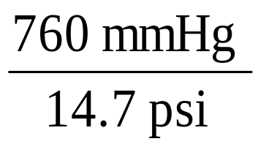
Example:
A high-performance road bicycle is inflated to a total pressure of 125 psi. What is the pressure in millimeters of mercury?
Information:
Given: 125 psi
Find: ? mmHg
Conversion Factor:
14.7 psi = 760 mmHg
Write a solution map for converting the units:
psi
mmHg

Slide 27
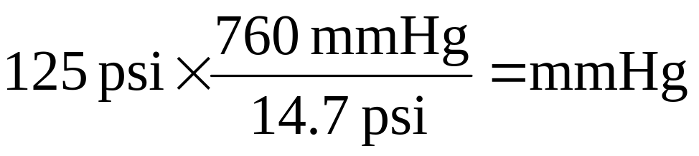
Example:
A high-performance road bicycle is inflated to a total pressure of 125 psi. What is the pressure in millimeters of mercury?
Information:
Given: 125 psi
Find: ? mmHg
Conversion Factor:
14.7 psi = 760 mmHg
Solution Map: psi → mmHg
Apply the solution map:
= 6.46259 x 10³ mmHg
= 6.46 x 10³ mmHg
Significant figures and round:
The 760 is an exact number
and does not effect the
significant figures.

Slide 28
Example:
A high-performance road bicycle is inflated to a total pressure of 125 psi. What is the pressure in millimeters of mercury?
Information:
Given: 125 psi
Find: ? mmHg
Conversion Factor:
14.7 psi = 760 mmHg
Solution Map: psi → mmHg
Check the solution:
125 psi = 6.46 x 10³ mmHg
The units of the answer, mmHg, are correct.
The magnitude of the answer makes sense
since mmHg are smaller than psi.
Tro's Introductory Chemistry, Chapter 11

Slide 29
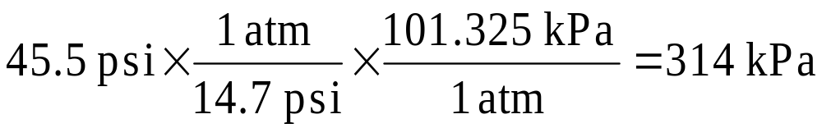
Practice — Convert 45.5 psi into kPa, Continued
Given:
Find:
45.5 psi
kPa
Concept Plan:
Relationships:
1 atm = 14.7 psi, 1 atm = 101.325 kPa
psi
atm
kPa
Solution:
Check:
Since kPa are smaller than psi, the answer makes sense.

